Slide 1
ICT-LEARNFACTORY
Multi-User-Applikationen
objektorientiert realisieren
DTOs und Services
08/16/26
Notes:
[Sources]
- Redesign follows the supplied ICT-LearnFactory Brand Guide (Aptos typography; Charcoal Flux #272726, Hyper Teal #45D9C7, Lumen Zest #D9EB12, Abyss Teal #29948C; geometric brand-mark pattern language).
- Slide content is preserved from the uploaded source presentation 05_DTOs-Services.odp.
[/Sources]

Slide 2
Ziele
Du weisst was DTOs sind und kennst deren Verwendungszweck
Du weisst wie du Entities in DTOs umwandeln kannst und umgekehrt
Du weisst wo das Service-Layer eingesetzt wird
ICT-LEARNFACTORY
DTOs Services
Notes:
[Sources]
- Redesign follows the supplied ICT-LearnFactory Brand Guide (Aptos typography; Charcoal Flux #272726, Hyper Teal #45D9C7, Lumen Zest #D9EB12, Abyss Teal #29948C; geometric brand-mark pattern language).
- Slide content is preserved from the uploaded source presentation 05_DTOs-Services.odp.
[/Sources]

Slide 3
DTO
Data Transfer Object
Repräsentation von Entities
Zur Übertragung von Daten
Senden ans Frontend
Minimiert auf das Nötigste
Kombinieren von Enitites
ICT-LEARNFACTORY
DTOs Services
Notes:
[Sources]
- Redesign follows the supplied ICT-LearnFactory Brand Guide (Aptos typography; Charcoal Flux #272726, Hyper Teal #45D9C7, Lumen Zest #D9EB12, Abyss Teal #29948C; geometric brand-mark pattern language).
- Slide content is preserved from the uploaded source presentation 05_DTOs-Services.odp.
[/Sources]

Slide 4
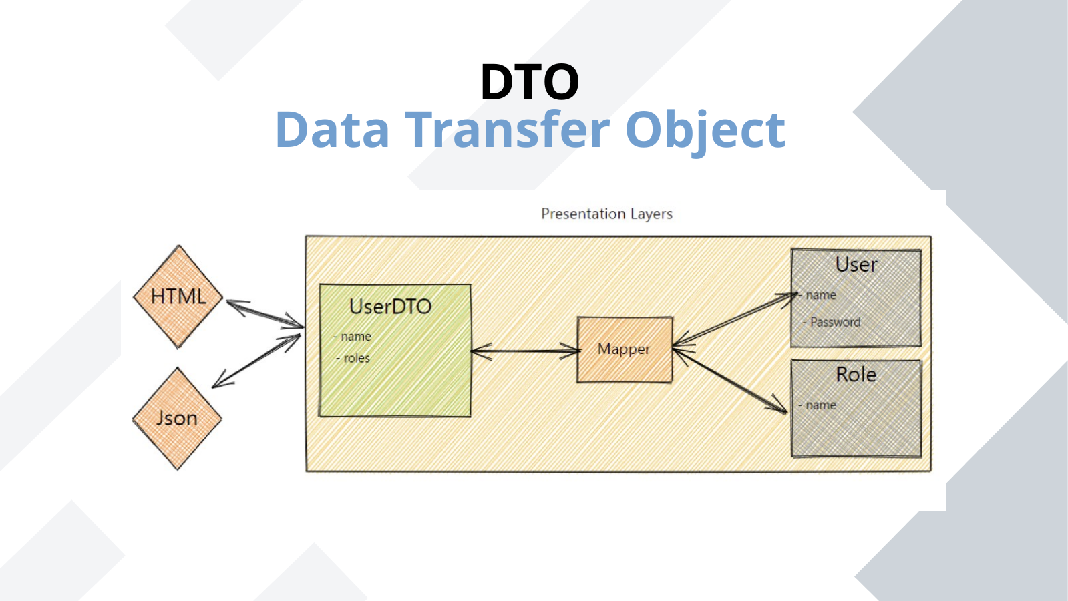
DTO
Data Transfer Object
ICT-LEARNFACTORY
DTOs Services
Notes:
[Sources]
- Redesign follows the supplied ICT-LearnFactory Brand Guide (Aptos typography; Charcoal Flux #272726, Hyper Teal #45D9C7, Lumen Zest #D9EB12, Abyss Teal #29948C; geometric brand-mark pattern language).
- Slide content is preserved from the uploaded source presentation 05_DTOs-Services.odp.
[/Sources]

Slide 5
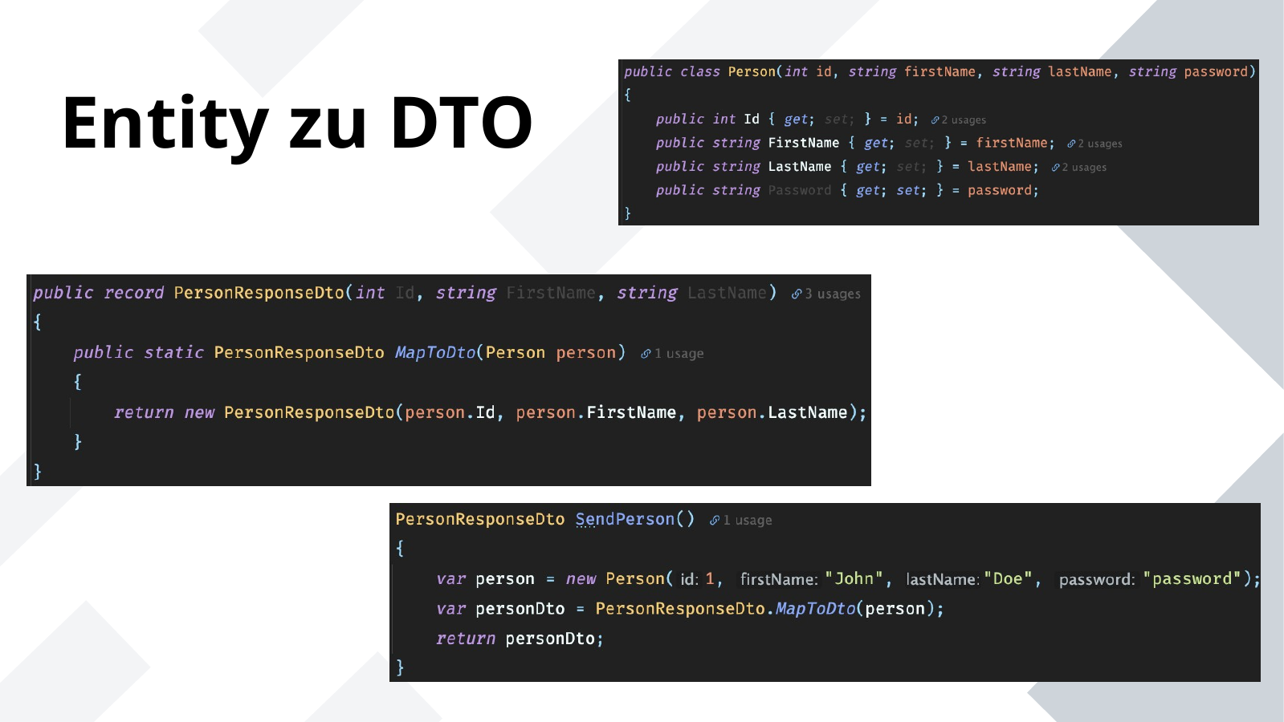
Entity zu DTO
ICT-LEARNFACTORY
DTOs Services
Notes:
[Sources]
- Redesign follows the supplied ICT-LearnFactory Brand Guide (Aptos typography; Charcoal Flux #272726, Hyper Teal #45D9C7, Lumen Zest #D9EB12, Abyss Teal #29948C; geometric brand-mark pattern language).
- Slide content is preserved from the uploaded source presentation 05_DTOs-Services.odp.
[/Sources]

Slide 6
DTO
Request vs Reponse
Response enthält meist mehr Felder
Bsp. Datenbank Id
Response als Erweiterung des Requests
Spezialfälle wie AuthRequest/AuthResponse
Request mit PW, Response mit Id
ICT-LEARNFACTORY
DTOs Services
Notes:
[Sources]
- Redesign follows the supplied ICT-LearnFactory Brand Guide (Aptos typography; Charcoal Flux #272726, Hyper Teal #45D9C7, Lumen Zest #D9EB12, Abyss Teal #29948C; geometric brand-mark pattern language).
- Slide content is preserved from the uploaded source presentation 05_DTOs-Services.odp.
[/Sources]

Slide 7
Mapping
Entity zu DTO und zurück
Der Controller erhält und sendet DTOs
Der Service und die Repositories verwenden Entities
Mapping Entity zu DTO und umgekehrt im Controller oder Service
ICT-LEARNFACTORY
DTOs Services
Notes:
[Sources]
- Redesign follows the supplied ICT-LearnFactory Brand Guide (Aptos typography; Charcoal Flux #272726, Hyper Teal #45D9C7, Lumen Zest #D9EB12, Abyss Teal #29948C; geometric brand-mark pattern language).
- Slide content is preserved from the uploaded source presentation 05_DTOs-Services.odp.
[/Sources]

Slide 8
Service
Separation of Concerns: Hält die Geschäftslogik getrennt von Controllern und Repositories.
Reusability: Die Geschäftslogik kann in verschiedenen Teilen der Anwendung wiederverwendet werden.
Testability: Services können unabhängig von der HTTP-Schicht mittels Unit-Tests getestet werden.
Vereinfachte Controller: Controller koordinieren lediglich den Ablauf zwischen den Services und der HTTP-Schicht.
Encapsulation: Services können Logik aus mehreren Repositories kombinieren oder komplexe Workflows abwickeln, die nicht in Controllern oder Repositories untergebracht werden sollten.
ICT-LEARNFACTORY
DTOs Services
Notes:
[Sources]
- Redesign follows the supplied ICT-LearnFactory Brand Guide (Aptos typography; Charcoal Flux #272726, Hyper Teal #45D9C7, Lumen Zest #D9EB12, Abyss Teal #29948C; geometric brand-mark pattern language).
- Slide content is preserved from the uploaded source presentation 05_DTOs-Services.odp.
[/Sources]

Slide 9
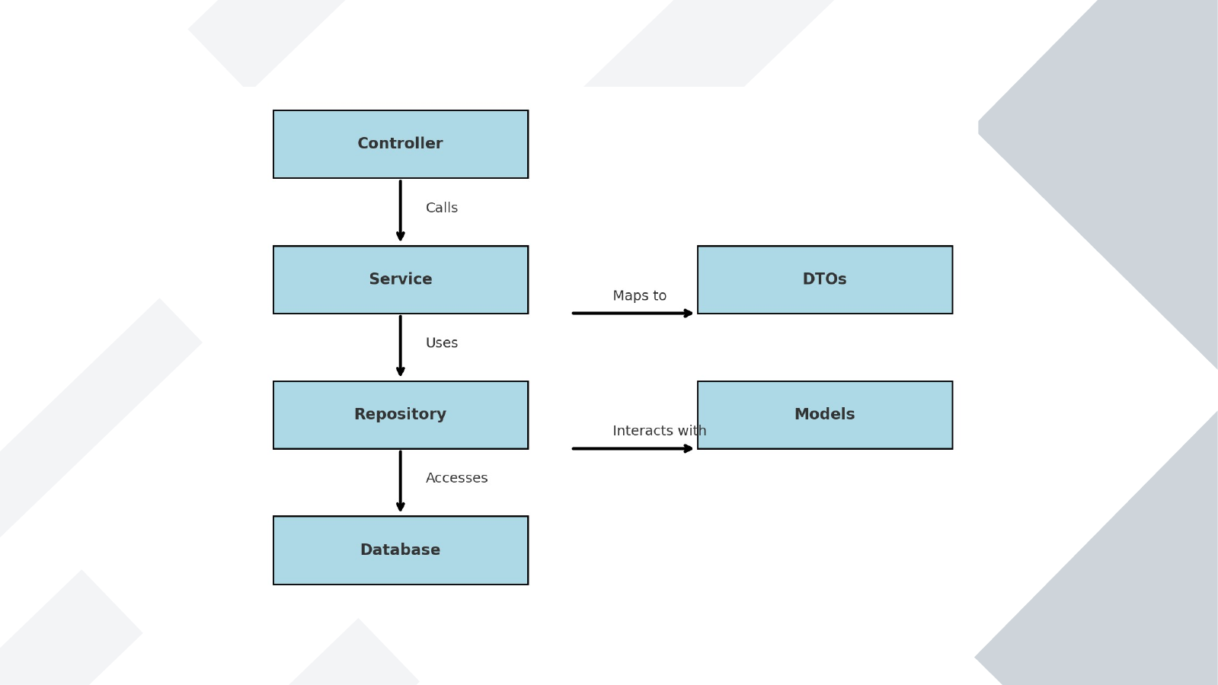
ICT-LEARNFACTORY
DTOs Services
Notes:
[Sources]
- Redesign follows the supplied ICT-LearnFactory Brand Guide (Aptos typography; Charcoal Flux #272726, Hyper Teal #45D9C7, Lumen Zest #D9EB12, Abyss Teal #29948C; geometric brand-mark pattern language).
- Slide content is preserved from the uploaded source presentation 05_DTOs-Services.odp.
[/Sources]

Slide 10
Fragen?
ICT-LEARNFACTORY
DTOs Services
Notes:
[Sources]
- Redesign follows the supplied ICT-LearnFactory Brand Guide (Aptos typography; Charcoal Flux #272726, Hyper Teal #45D9C7, Lumen Zest #D9EB12, Abyss Teal #29948C; geometric brand-mark pattern language).
- Slide content is preserved from the uploaded source presentation 05_DTOs-Services.odp.
[/Sources]

